Slide 1
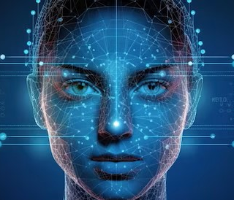
1
3
Problem Statement
Model Details
Build a face and expression recognition system.
Design Anti face spoofing system
Used 4 convolutional layers & 3 Fully connected layers
Used CrossEntropy loss, adam optimizer with learning rate 0.01
SVM model used for face recognition classification
2
4
Face and Expression Recognition
Group 7
Sudheendra
Surya
Sravani
Kusal
Uttam
Objective
Results of our Model
Use provided Siamese network to test face similarity
Build a classification model to detect face using Siamese network
We need to train the model with our own face samples with different expressions
Anti face spoofing validation
Training accuracy( FR) (~95%)
Test accuracy(( ER)( ~81%)
Accuracy from App for both FR & ER(~85%)

Slide 2
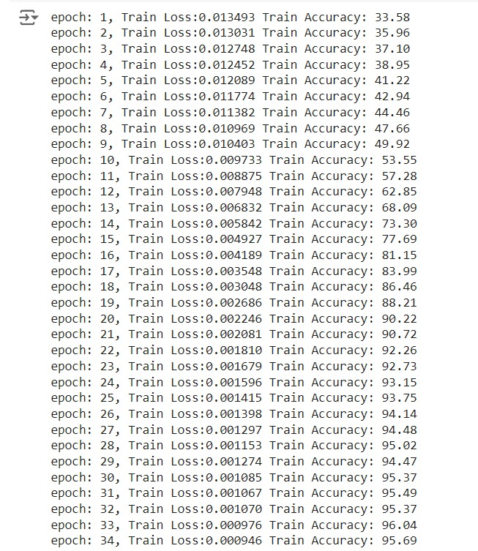

Training dataset & output
1.
Trained with 400 samples provided in AT&T dataset
158 (35 for test) our teammates data for face recognition
For face expression trained with 5 samples for each
expression, ~200 samples (40 for test)
Used provided Siamese model for face recognition
SVM classifier for classification for FR
Model is able to predict 7 to8 times correctly
out of 10 for FR and 9 to 10 times for ER

Slide 3
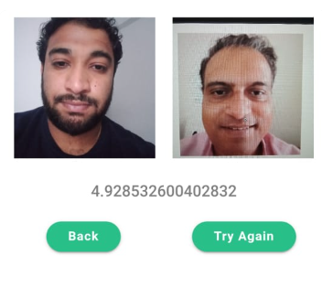
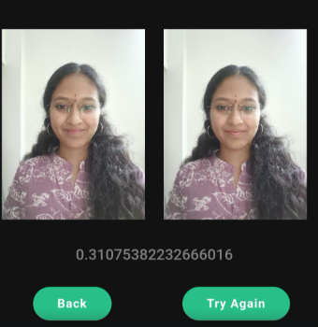
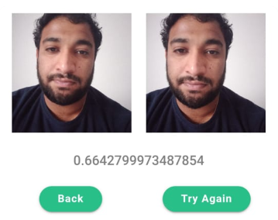
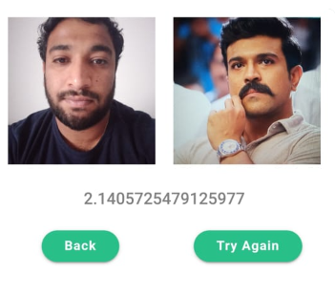
Testing outcomes-Face Similarity
Similarity_score < 1
Similarity _score < 1
Dissimilarity_score > 1

Slide 4
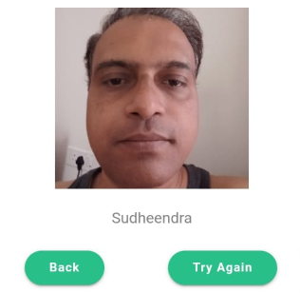
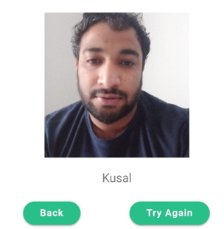
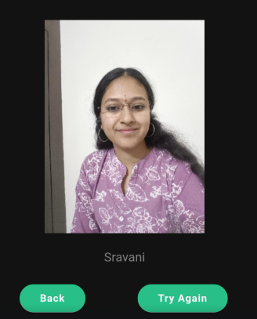
Testing outcomes-Face recognition

Slide 5

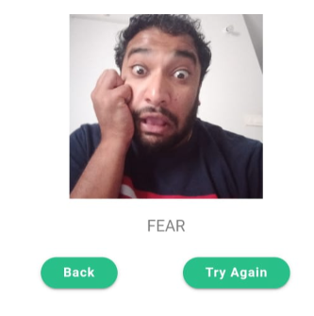
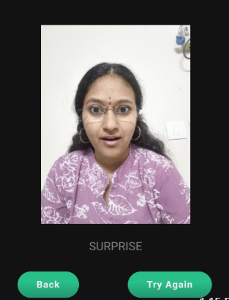
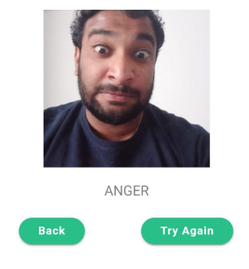
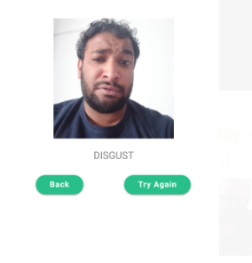
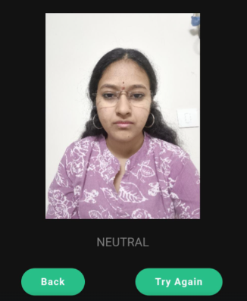
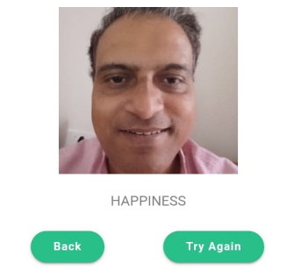
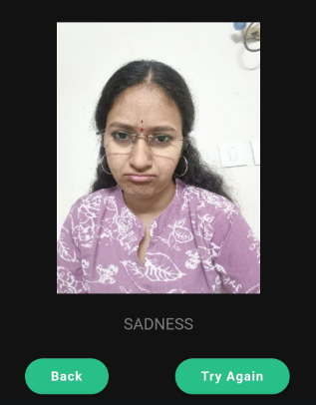
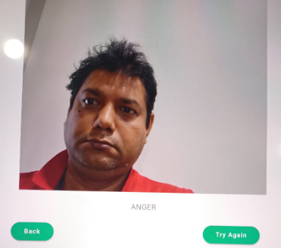
Testing outcomes-different expression recognition
Surprise, Happiness, Anger, Disgust, Fear, Neutral, Sadness

Slide 6
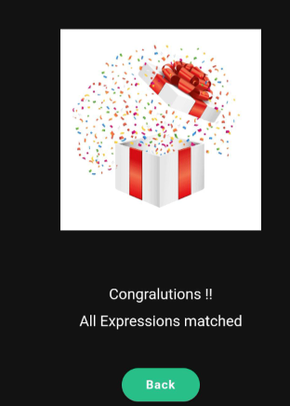
Testing outcomes-3 consecutive Sequence expression recognition
Surprise, Neutral, Sadness

Slide 7
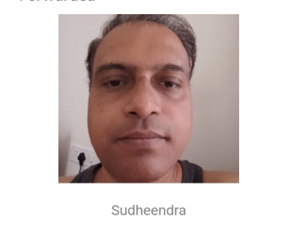
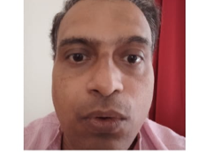
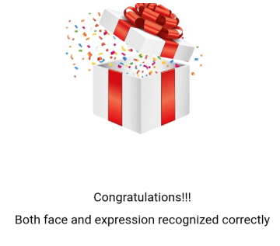
Testing outcomes-Anti Face Spoofing (case 1)

Slide 8
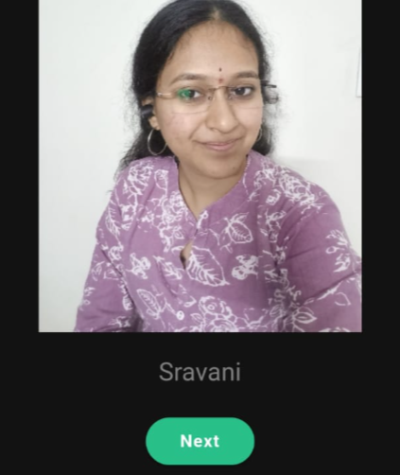
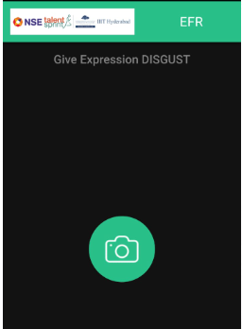

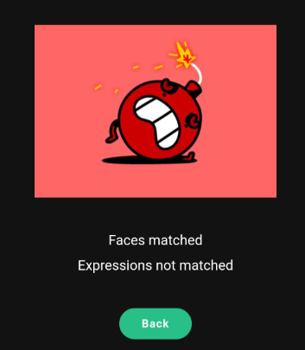
Testing outcomes-Anti Face Spoofing (case 2)

Slide 9
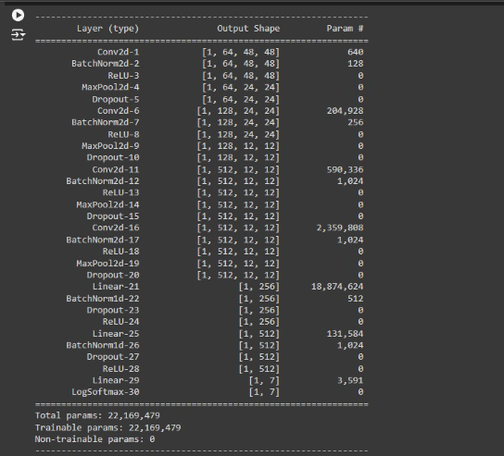
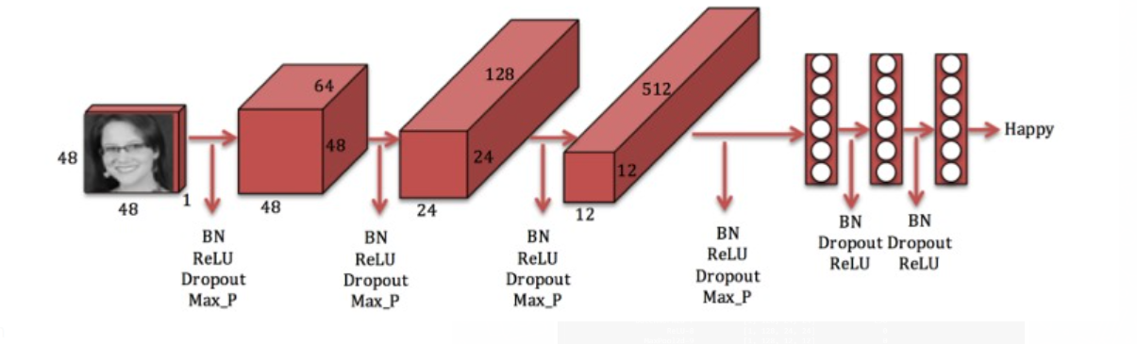
Summary of CNN layer for expression

Slide 10
Accuracy Comparison (with/without) team data
Type |  | Without Team samples | With more team samples
Face recoginition | Train Accuracy | ~97% | ~81%
 | Accuracy from App | 1 or 2 out of 10 | 7 to 8 out of 10
Face expression recognition | Train Accuracy | ~40% | ~95%
 | Accuracy from App | 2 to 3 out of 10 | 9 out of 10

Slide 11
Challenges
Underfitting – after increasing the samples.
Increased hidden layers (100 to 10k with 1000 iteration) in MLP
For SVM, tried with different kernels and class weights like rbf, balanced weights etc
Biased results – due to uneven samples of each classifiers.
Increased samples (~20 to ~160) with nearly same no for each classifiers
Incorrect labels for expression trained samples – Same labels used for different expressions
Added more samples (4 to 5 samples for each team member) for each expression

Slide 12
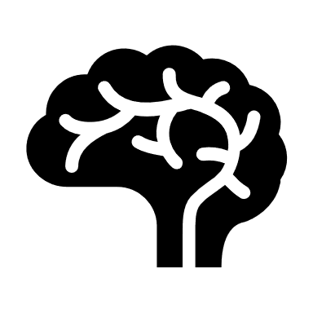
Q & A Thanks

